Slide 1
Algebraic Reconstruction Techniques on Sinogram Image of Solder Ball Grid
Rohit Das
Advised By – Prof. Chiou-Shann Fuh
61047086s@ntnu.edu.tw
+886-0905023713

Slide 2
Research progress
ART
MART

Slide 3

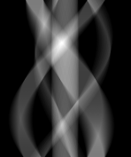


Research Progress
Changed the rotations and iterations on both ART and MART
179$°$
0$°$
Original Image
Original Sinogram

Slide 4
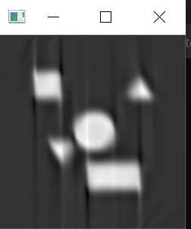
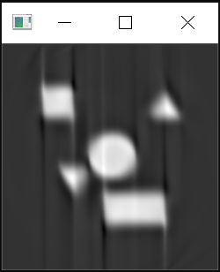
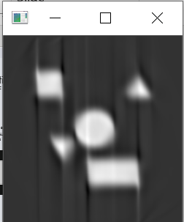
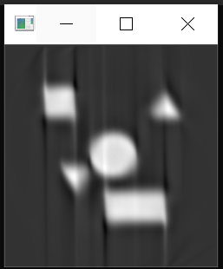

The Results Per Projection ART (Normalized)
$32$ iterations
50 iterations
180 iterations
500 Iterations

Slide 5
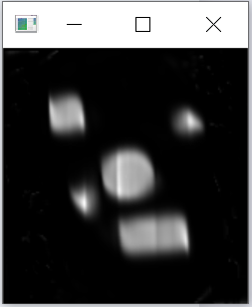
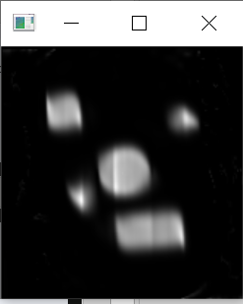
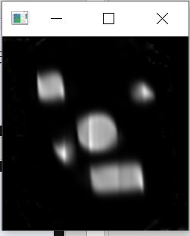
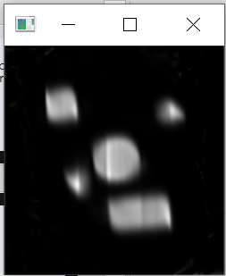

The Results Per Projection MART (Normalized)
$32$ iterations
50 iterations
180 iterations
500 Iterations

Slide 6
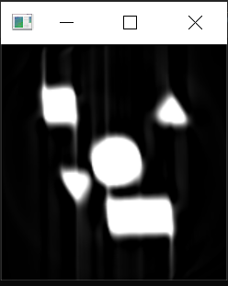
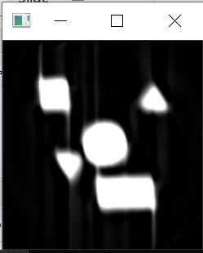
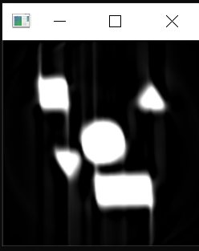
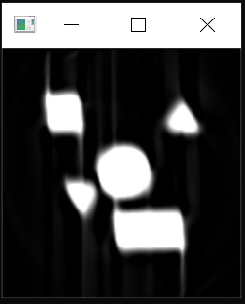
The Results Per Projection ART ( Not Normalized)
$32$ iterations
50 iterations
180 iterations
500 Iterations

Slide 7
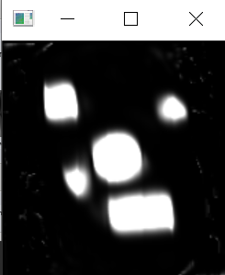
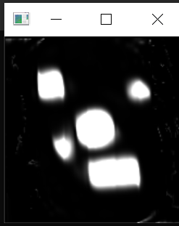

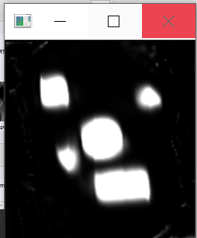
The Results Per Projection MART (Not Normalized)
$32$ iterations
50 iterations
180 iterations
500 Iterations

Slide 8
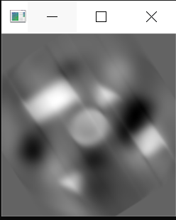
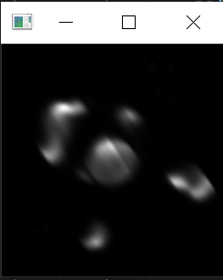
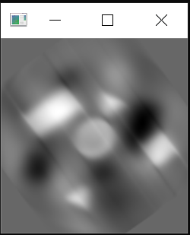
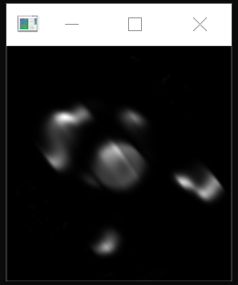
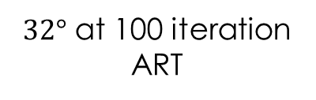
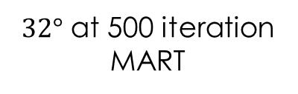
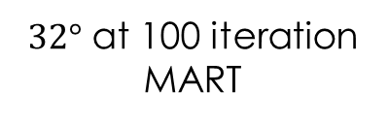
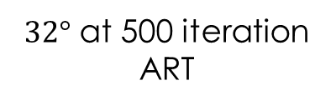
Changing Projections to 32$°$
$32°$ at 500 iteration ART
$32°$ at 500 iteration MART
$32°$ at 100 iteration ART
$32°$ at 100 iteration MART

Slide 9
Conclusion
ART is much better at keeping the shape, but there is a Halo effect which is quite difficult to remove.
MART loses the shape of the objects.
Under changing the projections, the shape formed from ART becomes much sharper which can be improved under post processing.
Under changing the projections, the shape formed from MART is not satisfactory.

Slide 10
Thank You!

